Slide 1
CSE322
Chomsky classification
Lecture #14

Slide 2
Chomsky's four types of grammars
Type-0 grammars (unrestricted grammars)
languages recognized by a Turing machine
Type-1 grammars (context-sensitive grammars)
Turing machine with bounded tape
Type-2 grammars (context-free grammars)
non-deterministic pushdown automaton
Type-3 grammars (regular grammars)
regular expressions, finite state automaton

Slide 3
Grammars, Languages, Machines
Type-0
Recursively enumerable Turing machine No restrictions
Type-1
Context-sensitive Linear-bounded αAβ -> αγβ
non-deterministic
Turing machine
Type-2
Context-free Non-deterministic A -> γ
pushdown automaton
Type-3
Regular Finite state automaton A -> aB
A -> a

Slide 4
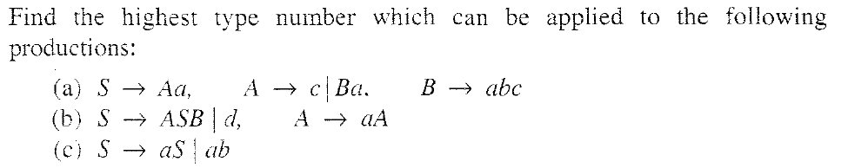
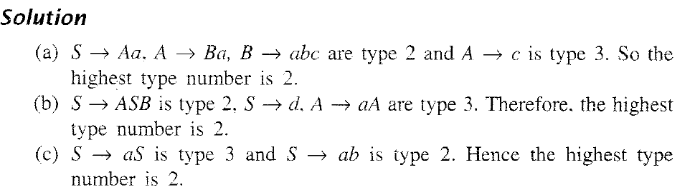
PROBLEM

